Slide 1

Accelerated discovery of inorganic thermoelectric materials
8 Nov 2024
KRICT ChemDX Hackathon

Slide 2
Background

Slide 3
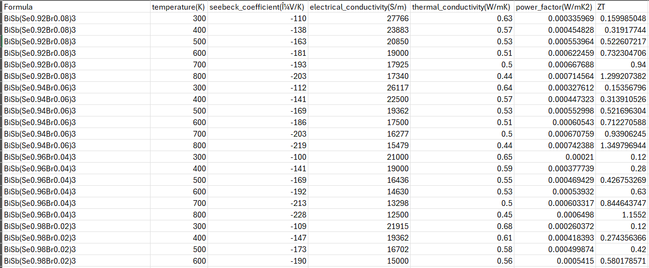
LitDX - Thermoelectrics

Slide 4
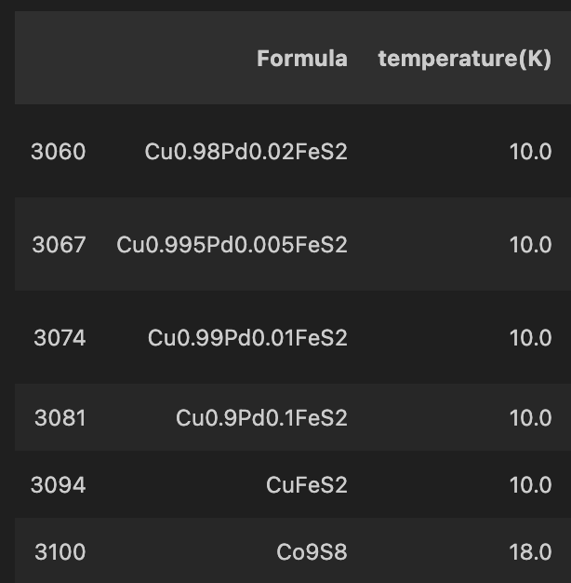
Dataset
Dataset size: 5205

Slide 5
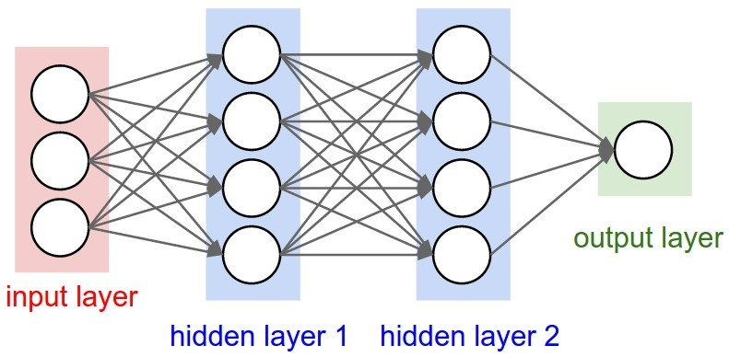
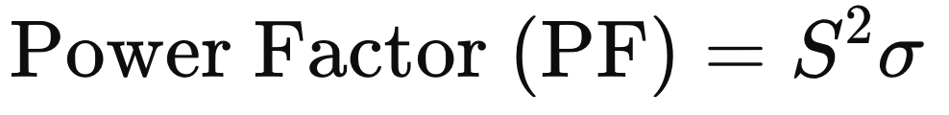
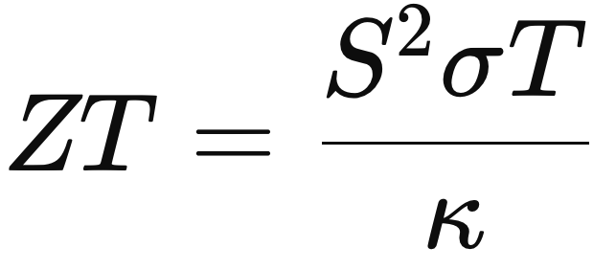


















Fingerprints and ML model architecture
Chemical Composition
Single-task
Multi-task
$x$₁, $x$₂, … , $x$_{n}
$x$₁, $x$₂, … , $x$_{n}
Stochiometric attributes
Elemental property statistics
Electronic structure attributes
Ionic compound attributes
Temperature
ML
$$\text{ML}$$
$$\text{ML}$$
$$\text{ML}$$
$$σ$$
$$s$$
$$k$$
$$σ$$
$$s$$
$$k$$
+
$$\text{Power} \text{Factor}$$
$$\text{ZT}$$
$$\text{Power} \text{Factor}$$
$$\text{ZT}$$
$$σ$$
$$s$$
$$k$$

Slide 6
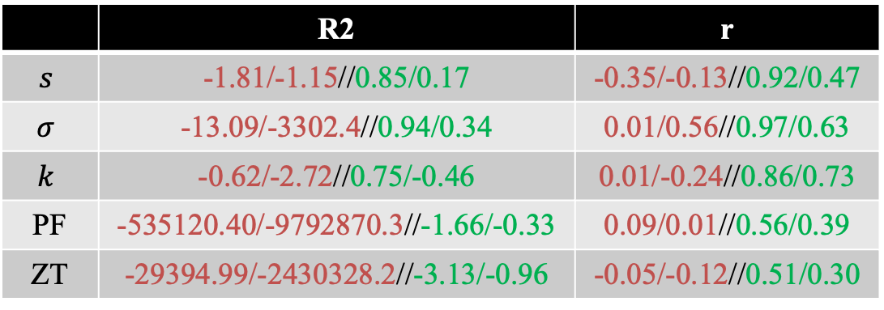
Model performance
Test1ST/Test2ST//Test1^{MT}/Test2^{MT}
 | R2 | r
$$s$$ | -1.81/-1.15//0.85/0.17 | -0.35/-0.13//0.92/0.47
$$σ$$ | -13.09/-3302.4//0.94/0.34 | 0.01/0.56//0.97/0.63
$$k$$ | -0.62/-2.72//0.75/-0.46 | 0.01/-0.24//0.86/0.73
PF | -535120.40/-9792870.3//-1.66/-0.33 | 0.09/0.01//0.56/0.39
ZT | -29394.99/-2430328.2//-3.13/-0.96 | -0.05/-0.12//0.51/0.30
Multi-task
ZT predicted < -5.0 are removed
Train and Validation: 3041 + 761
Test1: Unseen test data: 951
Test2: Unseen test data with material composition not present in the Train/Validation set: 450

Slide 7













Model training
RMSE: 0.752; R²: -3.130 r =0.512
RMSE: 0.497; R²: -0.963 r = 0.304
Single-task
Multi-task
r = -0.118
r = -0.045
$$x$$
$$x$$
ML
$$\text{ML}$$
$$\text{ML}$$
$$\text{ML}$$
$$σ$$
$$s$$
$$k$$
$$σ$$
$$s$$
$$k$$
$$\text{ZT}$$
$$\text{ZT}$$
ZT predicted < -5.0 are removed

Slide 8
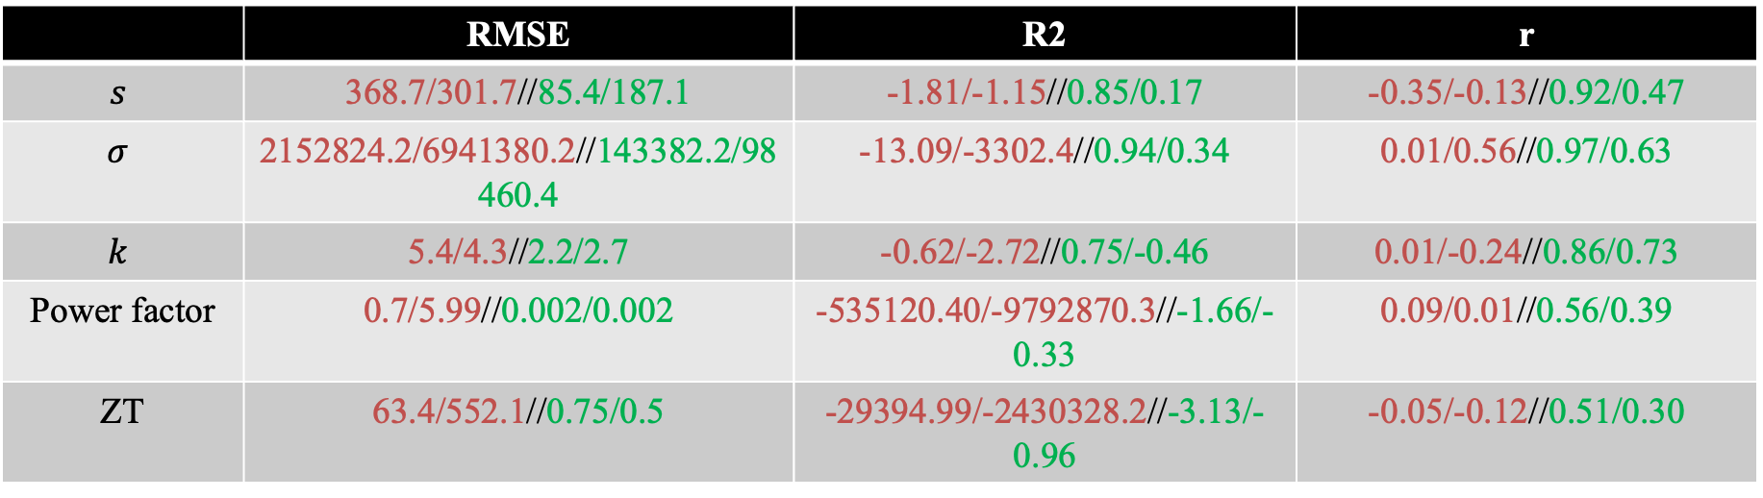
Model performance
Test1ST/Test2ST//Test1^{MT}/Test2^{MT}
 | RMSE | R2 | r
$$s$$ | 368.7/301.7//85.4/187.1 | -1.81/-1.15//0.85/0.17 | -0.35/-0.13//0.92/0.47
$$σ$$ | 2152824.2/6941380.2//143382.2/98460.4 | -13.09/-3302.4//0.94/0.34 | 0.01/0.56//0.97/0.63
$$k$$ | 5.4/4.3//2.2/2.7 | -0.62/-2.72//0.75/-0.46 | 0.01/-0.24//0.86/0.73
Power factor | 0.7/5.99//0.002/0.002 | -535120.40/-9792870.3//-1.66/-0.33 | 0.09/0.01//0.56/0.39
ZT | 63.4/552.1//0.75/0.5 | -29394.99/-2430328.2//-3.13/-0.96 | -0.05/-0.12//0.51/0.30

Slide 9
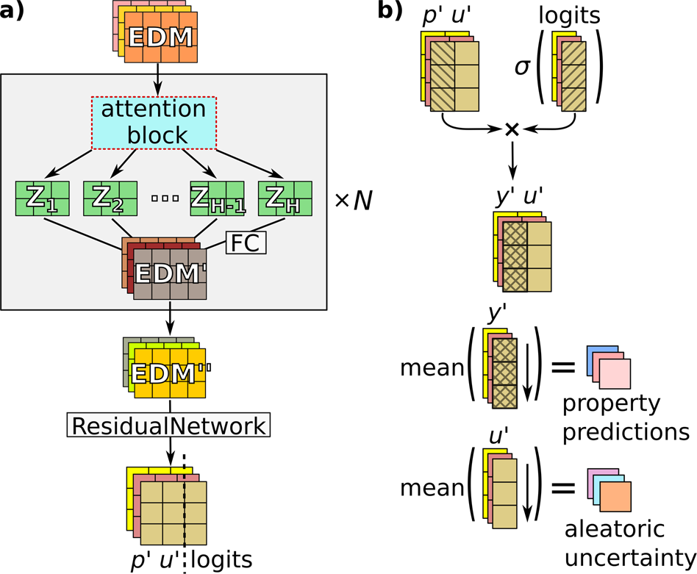
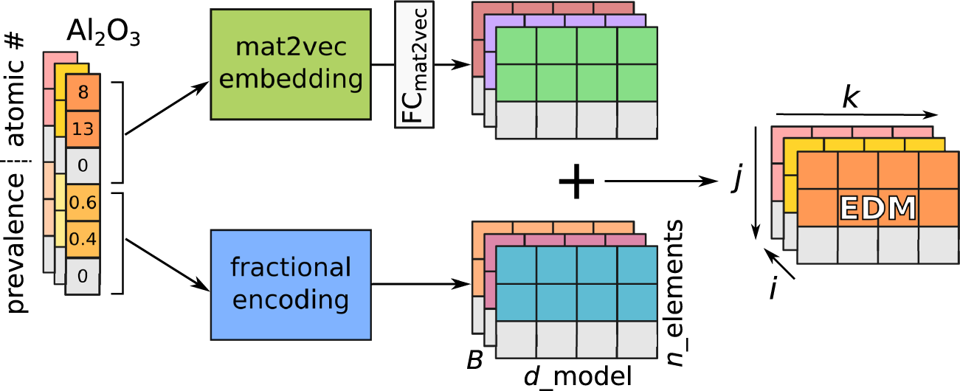
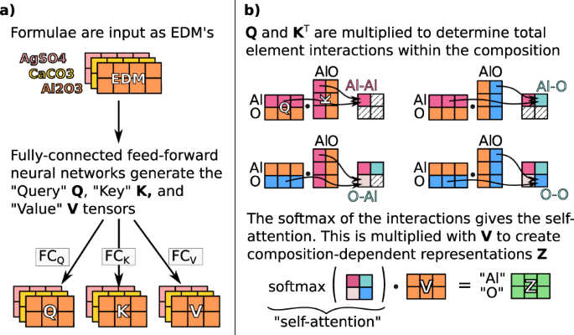
Model training
A Yang et al, npj Comp Mat, 2021, 10.1038/s41524-021-00545-1

Slide 10
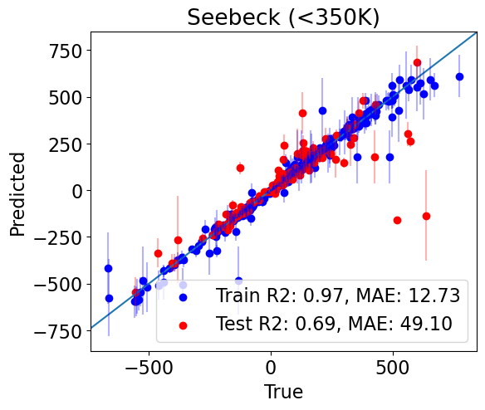
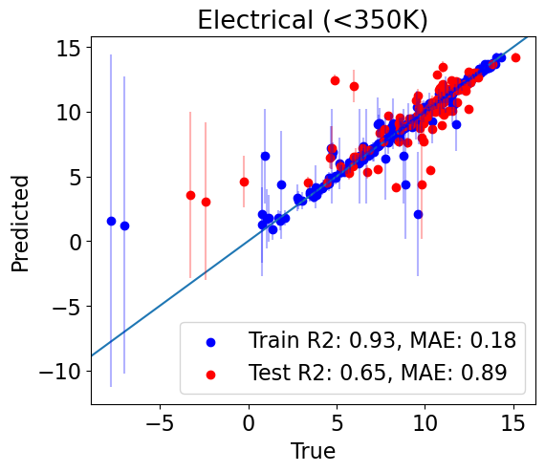
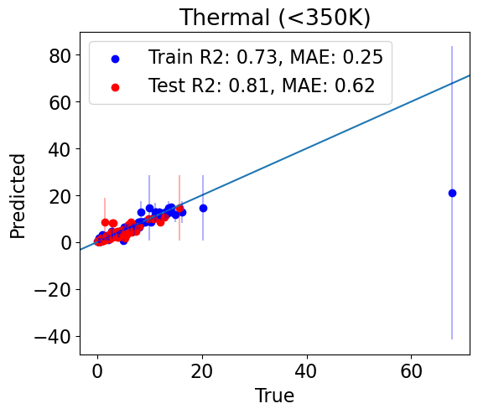
Model training
LiCoO2
TiS2, wrong magnitude

Slide 11
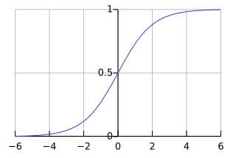
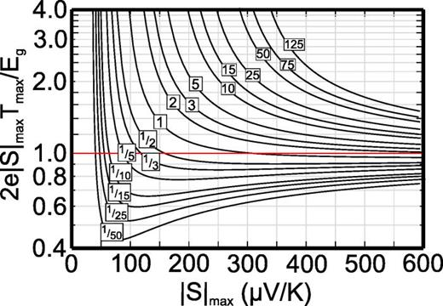
ZT-T curve fitting algorithm
Physics informed curve fitting using:
Melting point of the compounds (future)
Goldsmidt-Sharp limit ($E_{g}=2eS_{max}T_{max}$)
Z Gibbs et al, App Phys Lett, 2015, 10.1063/1.4905922

Slide 12
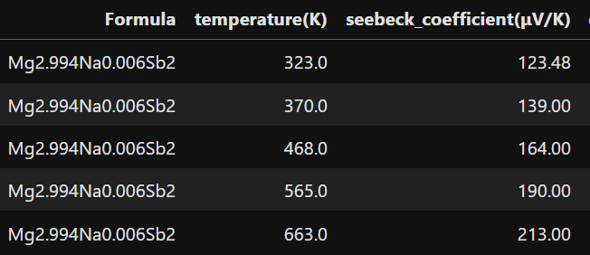
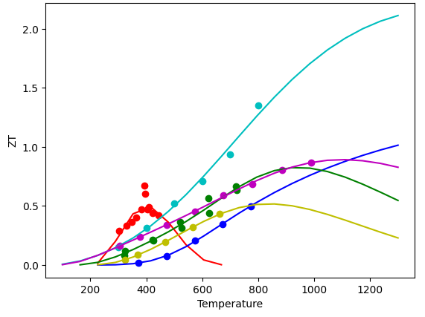
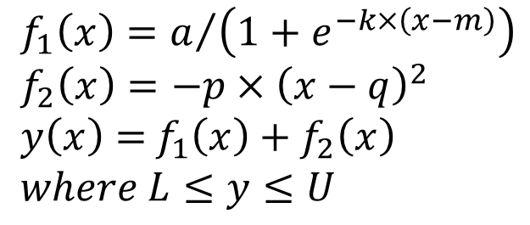
ZT-T curve fitting algorithm
$$f_{1}\left(x\right)=a/{\left(1+e^{−k×\left(x−m\right)}\right)}$$
$$f_{2}\left(x\right)=−p×{\left(x−q\right)}^{2}$$
$y\left(x\right)=$ $f_{1}\left(x\right)+f_{2}\left(x\right)$
$$where L≤y≤U$$
T_{max} with margin

Slide 13
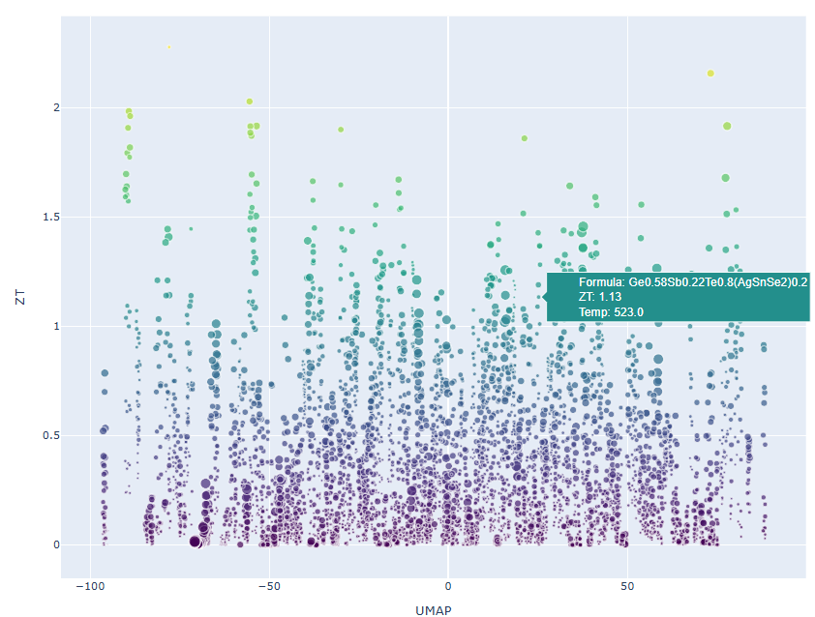
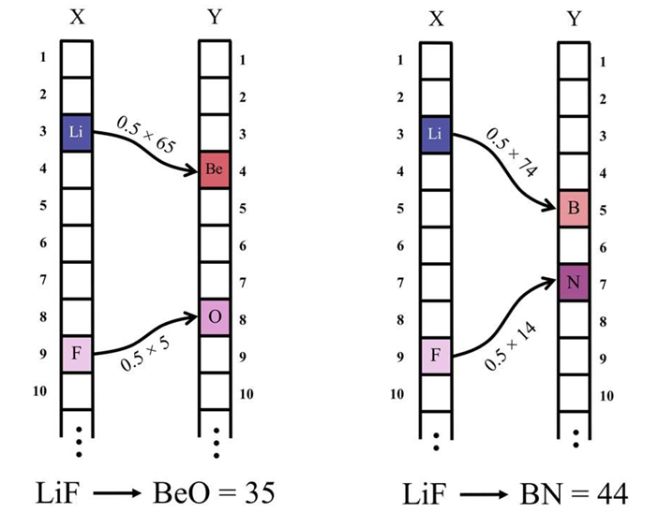
Visualization via Elemental Movers Distance (ElMD
C Hargreaves et al, Chem Mater, 2020, 10.1021/acs.chemmater.0c03381

Slide 14
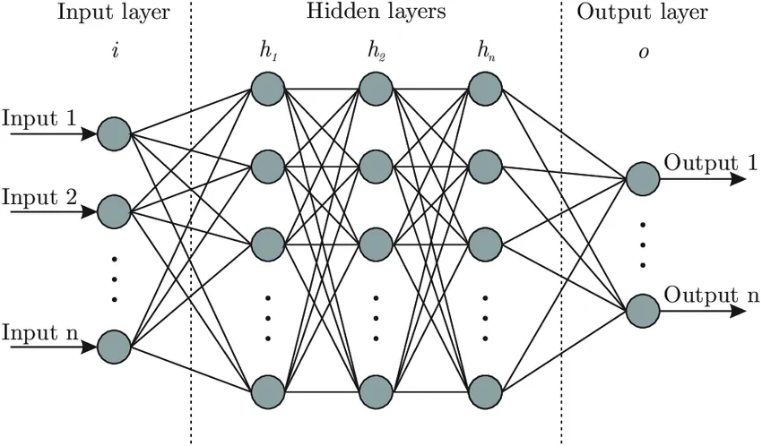
Active learning workflow
1. Dataset of TE materials
2. Multi-task ML model
3. Compute and extrapolate ZT-T curve
4. Sample/optimize chemical similarity and ZT at target T

Slide 15
Active learning demonstration
Initial model
Updated model
Experiments
Data for BiSb(Se0.92Br0.08)3 at 500 K and 800K are added to the train set

Slide 16
Contributions
ML property prediction for S, σ and κ
ZT-T curve fitting algorithm with informed physics
Visualization tool for chemical space
Workflow for sampling/optimization of Tes
Re

Slide 17
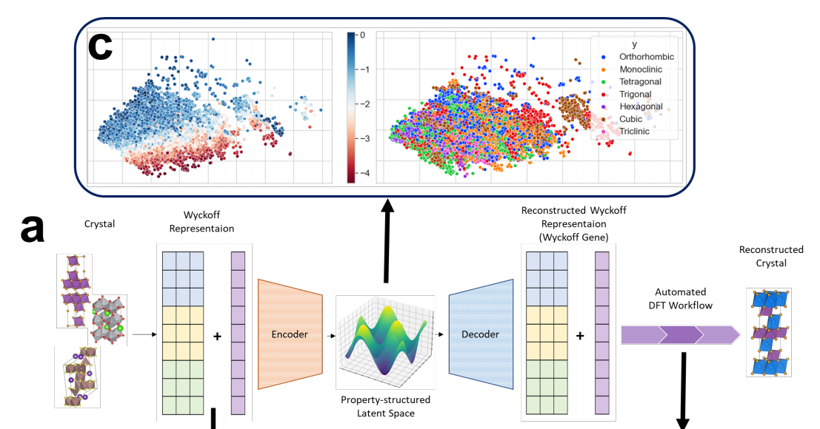
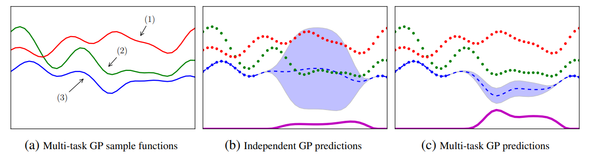
Future work
Wang et al. npj Comput Mater 7, 77 (2021)
Zhu et. al. Matter 7, 10, 3469-3488 (2024)

Slide 18
Thank you!

